Slide 1

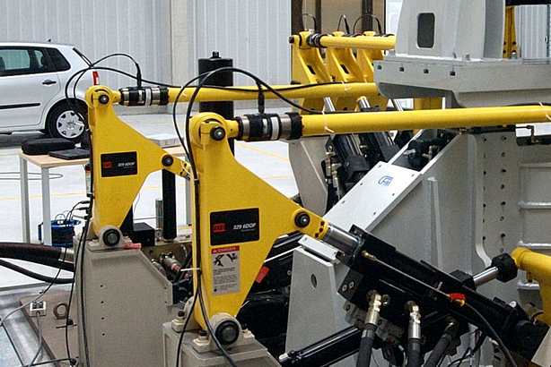
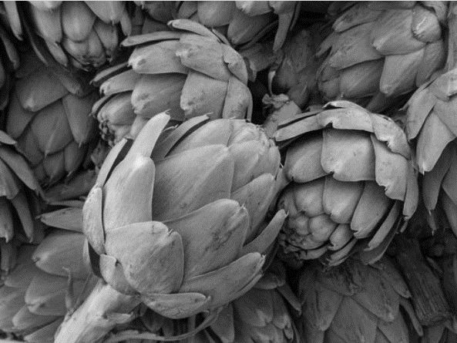


Bruselako Ordezkaritza
Delegación en Bruselas
X Encuentro Empleo y Emprendimiento UPna

Slide 2

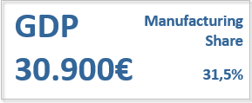

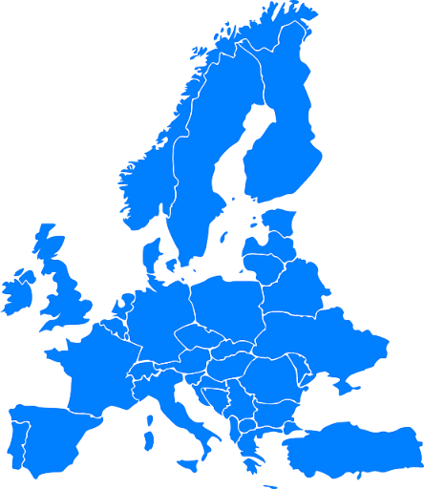
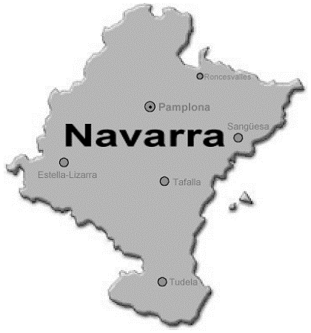


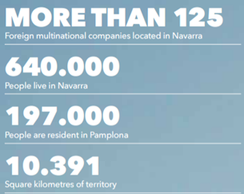

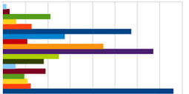
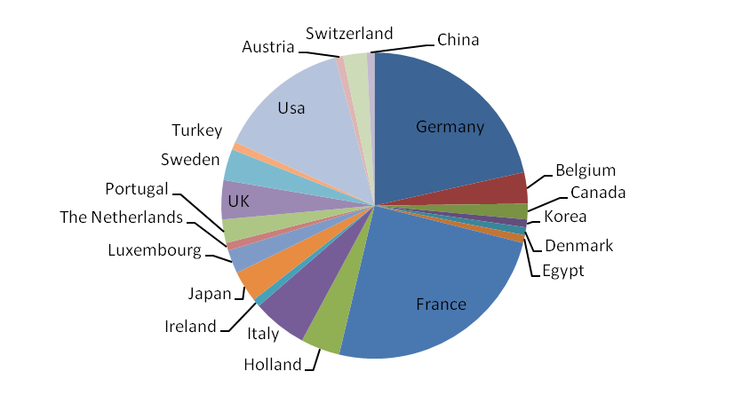
NAVARRA/NAFARROA IN EUROPE
The Comunidad Foral de Navarra, is located in the North of Spain. It is bordered, to the east, by the regions of Aragon and La Rioja, and to the northwest by the Basque Country.
Over 125 multinational companies
from 20 different countries
NAVARRA
Pamplona/Iruña is the capital of the region.

Slide 3
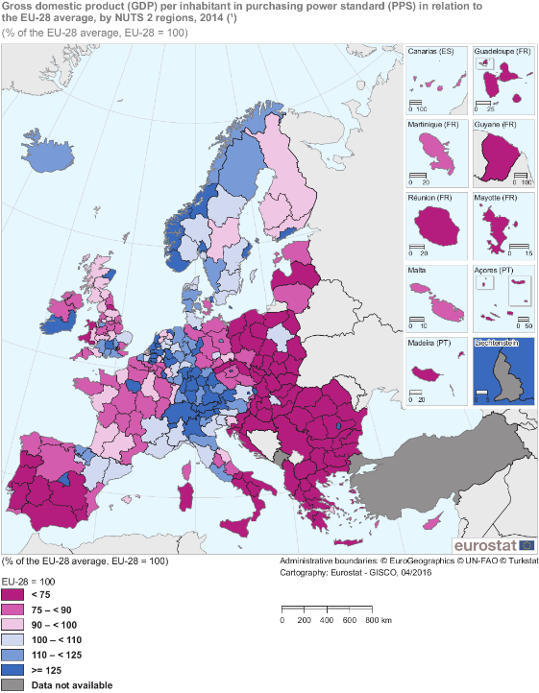

Navarra in terms of prosperity
In 2017, Standard & Poor’s holds Navarra’s rating to ‘A‘, two levels above Spain’s rating (BBB+): “Navarre's high fiscal autonomy and sound financial management make it more resilient in a stress scenario than Spain. We consequently rate Navarre two notches higher than Spain”.
“Navarre's economy is wealthier, more competitive, and more export oriented than Spain's, in our opinion”
Growth for the region’s Gross Domestic Product (GDP) for 2016: 3,1% .
Navarra, with a per capita GDP of € 30,682 in 2016, is in third place among the Spanish regions.

Slide 4





Navarra Innovation System
6 TECHNOLOGICAL CENTRES
Non profit innovative institutions focused on development of technology to be deployed in industry.
3 RESEARCH CENTRES
Non profit R&D institutions focused on generating new knowledge.
2 UNIVERSITIES
High level academic institutions focused on teaching but also on basic scientific research activity.
http://sodena.com/index.php/es/estrategia-regional

Slide 5
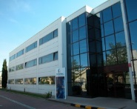
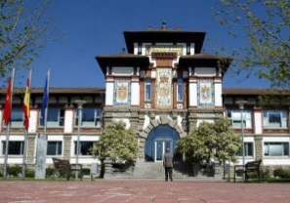
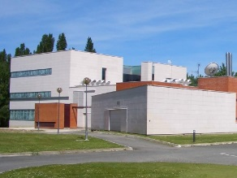
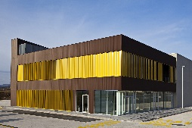
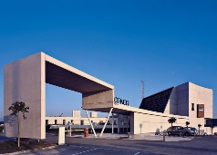

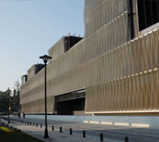
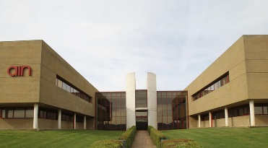
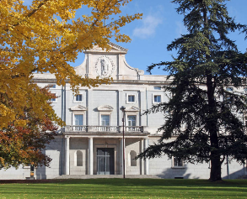
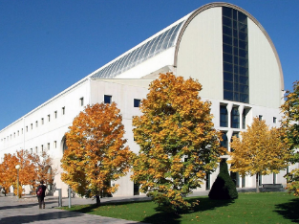
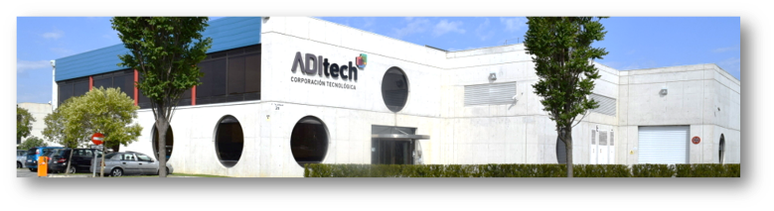
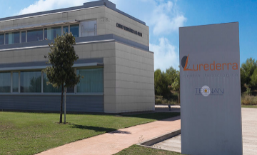
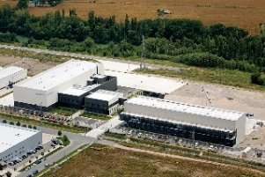

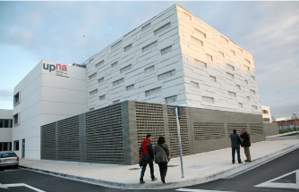
GENERAL OVERVIEW – INFRASTRUCTURES and LOCATION
Automotion
and Mechatronics
Noáin
Pamplona
Estella
Cordovilla
Los Arcos
Food Chain
San Adrián
Villava
Mutilva
Villava/Atarrabia
Pamplona/Iruña
Sarriguren
Aoiz/Agoitz
Renewable Energy
and Resources
Sarriguren
Sangüesa
Aoiz
Cordovilla
Mutilva/Mutiloa
Estella/Lizarra
Noain
Los Arcos
Sangüesa/Zangoza
Health
Pamplona
San Adrián
Universities
Pamplona
Tudela
Tudela
Technology Corporation

Slide 6












NAVARRA INNOVATION SYSTEM
Notes:
Resumen logos o resumen general

Slide 7



EU INSTITUTIONS & BODIES
Paid traineeships
Compulsory unpaid traineeships
Traineeships for students of national administration schools
http://www.consilium.europa.eu/en/general-secretariat/jobs/traineeships/
Traineeships for university graduates (called Robert Schuman traineeships)
Translation traineeships for university graduates
Translation training placements
Conference interpreters
http://www.europarl.europa.eu/atyourservice/en/20150201PVL00047/Traineeships
Notes:
Resumen logos o resumen general

Slide 8


EU INSTITUTIONS & BODIES
A paid traineeship of 5 months with the European Commission, starting on either 1st March or 1st October.
You will receive a monthly grant of 1,159.40 € as of 1st March 2017 and reimbursement of travel expenses. Accident and health insurance can also be provided.
Every year, there are about 1,300 places available.
If you are one of the selected candidates you get hands-on experience in the international and multicultural environment. This can be an important enrichment for your further career.
https://ec.europa.eu/stages/about/whats-in-it-for-you_en
El Tribunal de Justicia de la Unión Europea ofrece cada año un número limitado de plazas para realizar prácticas remuneradas, de una duración de cinco meses.
Las prácticas se desarrollan principalmente en la Dirección General de Traducción, en la Dirección de Investigación y Documentación, en la Dirección de Comunicación, en la Dirección de Protocolo y de Visitas, en el servicio del Consultor jurídico para asuntos administrativos, en la Secretaría del Tribunal General y en la Dirección de Interpretación (respecto a las prácticas en la Dirección de Interpretación, véase infra). Los candidatos, que han de poseer un título universitario en Derecho o Ciencias Políticas (especialidad Derecho) o, para las prácticas en la Dirección de Interpretación, un título de intérprete de conferencias, deberán presentar sus candidaturas a través de la aplicación EU CV Online en los plazos fijados.
El importe de la beca asciende a 1 120,00 € netos al mes.
Por razones de servicio, es conveniente poseer un buen conocimiento del francés.
https://curia.europa.eu/jcms/jcms/Jo2_10338/
Notes:
Resumen logos o resumen general

Slide 9


EU INSTITUTIONS & BODIES
The aim of the traineeship within the CoR is:
  to provide a unique, first-hand experience of the workings of the CoR in particular, and of the EU institutions in general
  to acquire practical experience and knowledge of the day-to-day work of the Committee's departments
  to work in a multicultural and multilingual environment
  to put into practice knowledge acquired during studies, particularly in your areas of competence
Access to a traineeship is on merit only. For this reason, the CoR does not make preferential arrangements with specific educational institutions or authorities.
http://www.cor.europa.eu/en/about/traineeships/pages/traineeships.aspx
Long-term traineeship
Short-term traineeship
http://www.eesc.europa.eu/en/work-with-us/traineeships
Notes:
Resumen logos o resumen general

Slide 10


EU INSTITUTIONS & BODIES
The Ombudsman offers traineeships, twice a year, primarily to university graduates or equivalent. The traineeships take place either in Strasbourg or in Brussels according to the needs of the Office. They start on 1 September and 1 January each year.
Trainees in the Ombudsman's Office must necessarily have a very good command of the English language. Applications must therefore be submitted in English. For the same reasons, the documents concerning traineeship applications are only available in English.
Traineeship offer - Web developer trainee - OMB/T/2017/S4 (31/10/2017)
https://www.ombudsman.europa.eu/trainee/en/default.htm
In 2005, the EDPS launched its traineeship programme. The main objective is to offer recent university graduates the opportunity to put into practice the knowledge acquired during their studies, particularly in their specific areas of competence.
Traineeships allow trainees to acquire practical experience of the EDPS’ day-to-day activities as well as in data protection.
Twice a year, our traineeship programme hosts on average six trainees. The traineeship sessions start in October and March, each for a five-month period
https://edps.europa.eu/about-edps/recruitment_en
Notes:
Resumen logos o resumen general

Slide 11

EU INSTITUTIONS & BODIES
Trainership
Entry-level graduate:
For a typical graduate competition, an application process includes the following steps:
1. Read the Notice of Competition about the profile you are interested in and make sure you fulfil the eligibility criteria.
2. Put yourself to the test with the self-assessment exercises and fill in your online application at Login.
3. If your application is valid, we invite you to sit a set of Computer-based Multiple-Choice Question (MCQ) tests.
4. If you are amongst the best scoring candidates in these tests, we invite you to the e-tray, an intermediate test done on computer.
5. If you meet the eligibility criteria and score one of the highest score in the e-tray, we invite you to the competency-based Assessment Centre in Brussels.
https://epso.europa.eu/
Notes:
Resumen logos o resumen general

Slide 12
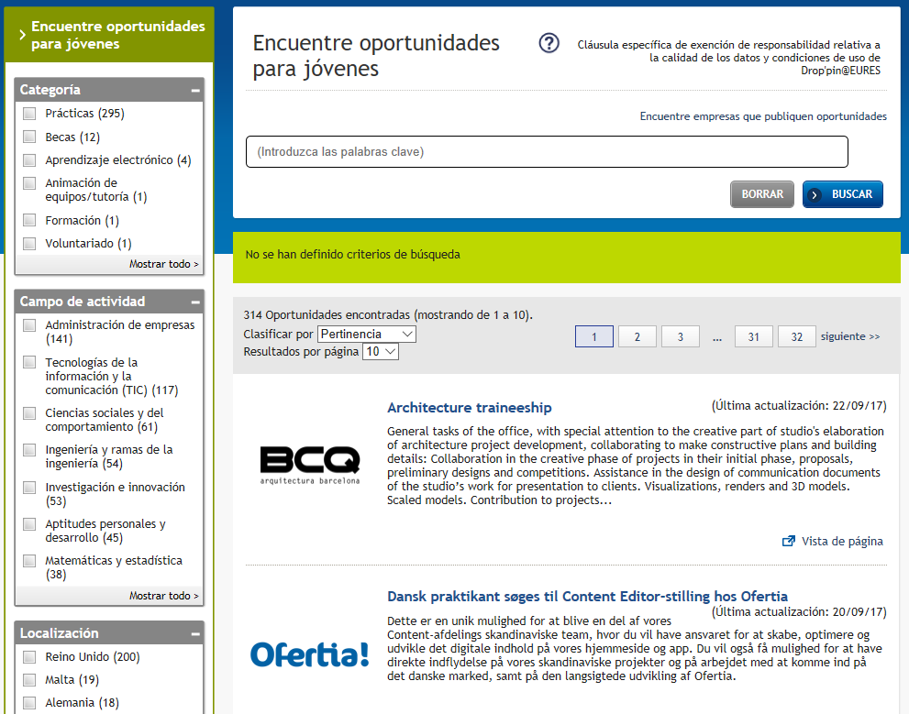

EURES
https://ec.europa.eu/eures/public/es/homepage
Notes:
Resumen logos o resumen general

Slide 13

EURES
https://www.europeanjobdays.eu/
Notes:
Resumen logos o resumen general

Slide 14


EU INSTITUTIONS & BODIES
Las instituciones, organismos y agencias de la UE disponen de diversos programas de prácticas dirigidos a titulados superiores y a estudiantes universitarios con el objetivo de que se familiaricen con la Administración comunitaria, aumenten su cualificación profesional o, en su caso, complementen los correspondientes estudios académicos.
Además, la Unidad de apoyo para la presencia de españoles en las instituciones de la UE elabora un calendario anual con todos los programas y sus respectivos plazos de presentación de solicitudes y publica un boletín informativo de periodicidad quincenal que recoge las convocatorias con el plazo de inscripción abierto.
https://www.exteriores.gob.es/RepresentacionesPermanentes/EspanaUE/es/TrabajarenUE/Paginas/Practicas.aspx
Apoyar a las empresas en su proceso de internacionalización, mediante la puesta a disposición de jóvenes profesionales formados y especializados previamente en la Red Exterior de la Secretaría de Estado de Comercio, para que culminen su proceso de formación en el entorno empresarial, buscando su integración en el ámbito laboral.
En el caso de que la beca se desarrolle fuera de España es requisito obligatorio que las empresas estén implantadas en el exterior y dispongan de un tutor permanente en el destino propuesto.
DOTACIÓN DEL BECARIO. ICEX cubre el 50% de la dotación bruta anual si las prácticas se desarrollan en una PYME o entidad, y el 30% de la dotación bruta anual en caso de que se desarrollen en una GRAN empresa
La dotación de las prácticas viene fijada por ICEX, no siendo un concepto negociable. Su importe oscila entre 21.000 € y 48.000 € brutos anuales en función del destino asignado. La dotación bruta anual para España queda establecida en 23.000 €.
http://www.icex.es/icex/es/navegacion-principal/todos-nuestros-servicios/formacion/becas/conoce-las-becas-icex/index.html
Notes:
Resumen logos o resumen general

Slide 15

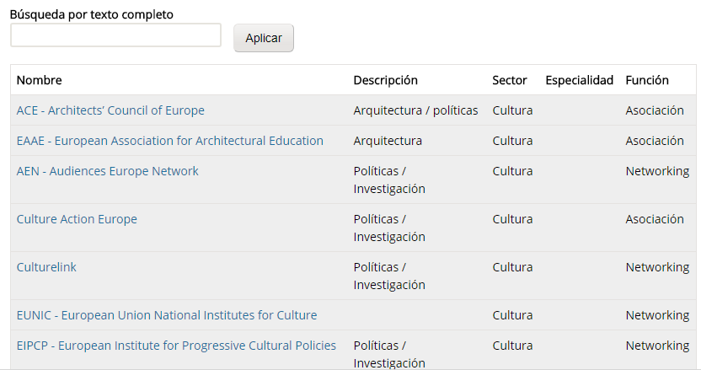
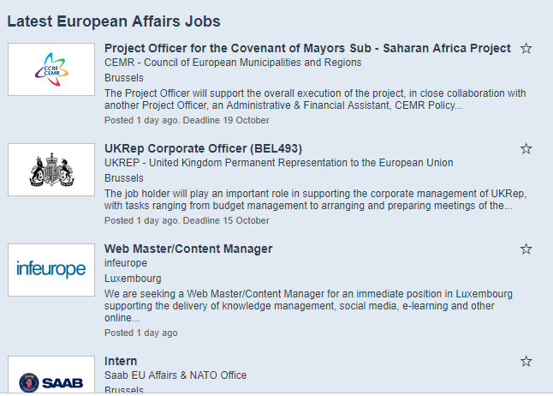

REDES
http://na.bruselas.site/es/redes
Notes:
Resumen logos o resumen general

Slide 16



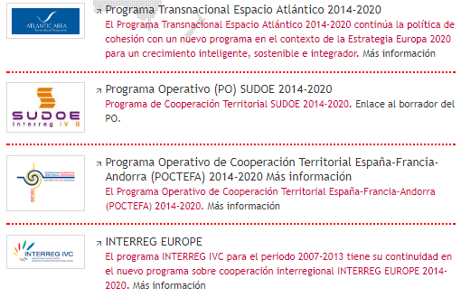
REDES
http://na.bruselas.site
http://www.navarra.es/home_es/Gobierno+de+Navarra/Organigrama/Los+departamentos/Economia+y+Hacienda/Organigrama/El+departamento/Internacionalizacion/PIN/
Notes:
Resumen logos o resumen general

Slide 17
“Navarre shall be the wonder of the world”
W. Shakespeare, Loves Labours Lost, (Act I, Scene I)
Mr. Mikel Irujo
Delegate Government of Navarra in Brussels
Rue du Pascale, 16
B1000
Brussels - Belgium
mirujoam@navarra.es

